Slide 1
Netsparker Vulnerability Report
Domain: https://zero.webappsecurity.com/
Made by: Khalid Shaikh

Slide 2
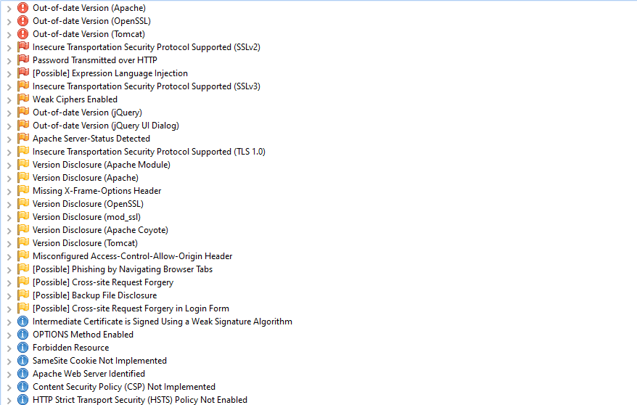
Basic Vulnerability List

Slide 3
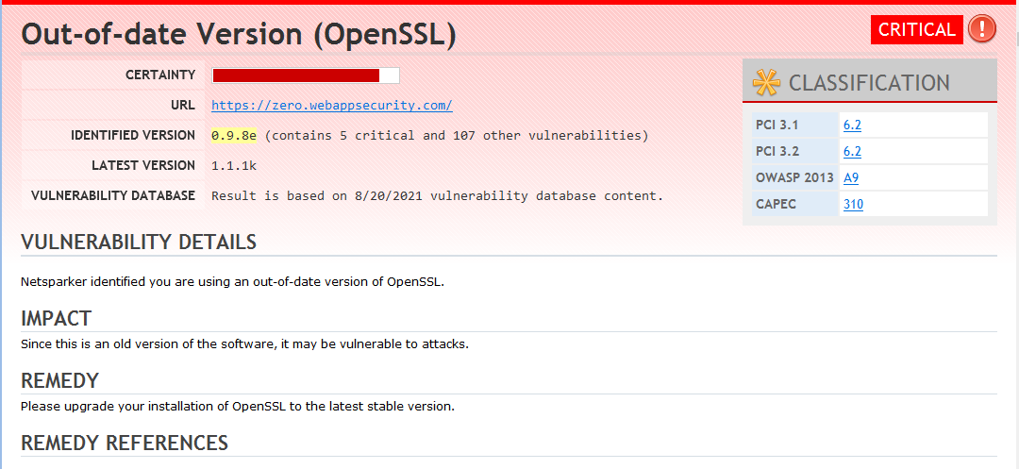
Netsparker Generated Report

Slide 4
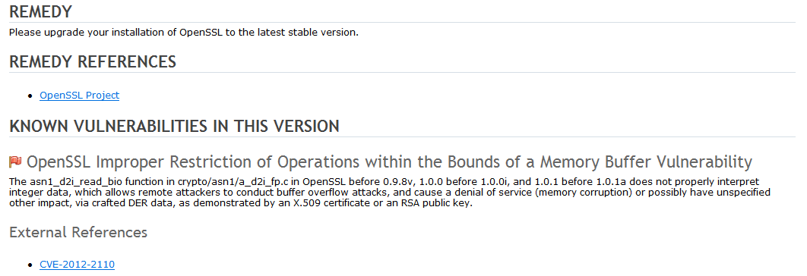

Slide 5
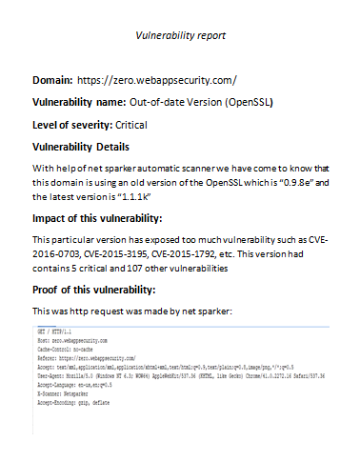
Report created by me

Slide 6
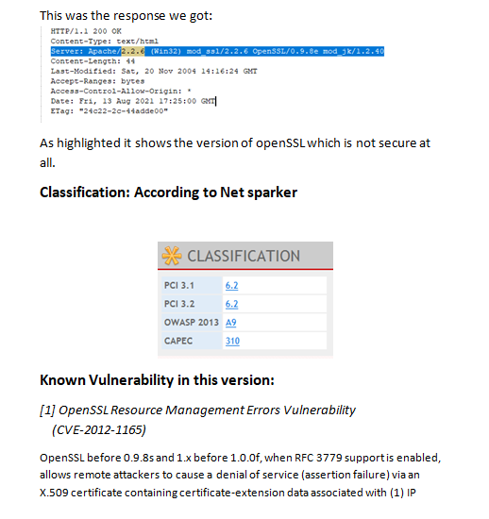

Slide 7
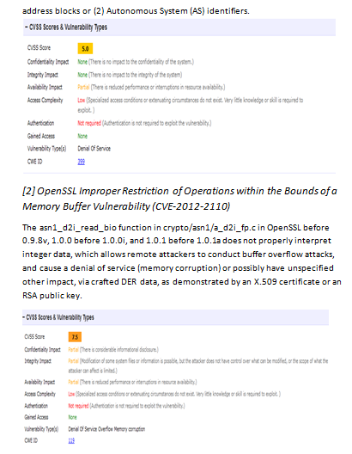

Slide 8
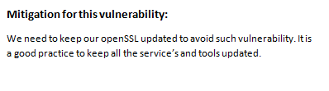
Last Page

Slide 9
Thank you
For reference:
I have also attached original report file in the repository.

